Slide 1

Why this can be happen to me?

Slide 2
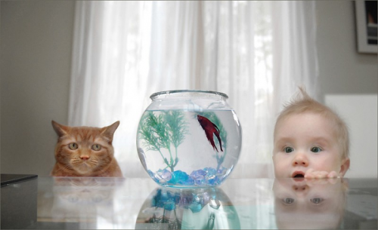
Can you think, who’ll be the faster catch the fish??

Slide 3
Chapter 3
Special Distribution

Slide 4

What’s distribution we learn for????

Slide 5
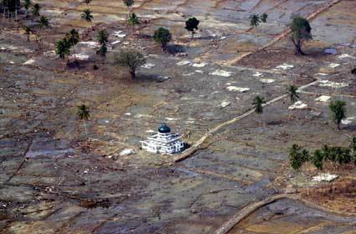
An Applied Example about Distribution ; discrete/ continue
Premium value in insurance industry

Slide 6


DISCRETE UNIFORM DISTRIBUTION
Example :
The first digit of a part’s serial number is equally likely to be any one of the digits 0 through 9. If one part is selected from a large batch and X is the first digit of the serial number, X has a discrete uniform distribution with probability 0.1 for each value.
R={0,1,…9} → f(x)=0.1 for each value in R

Slide 7
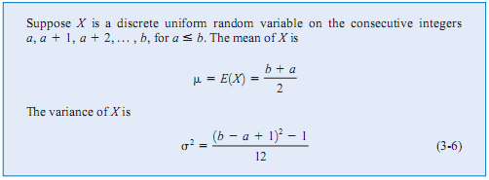
Mean & Variance discrete UNIFORM
Prove it (H1)

Slide 8
Example
Let the random variable Y denote the proportion of the 48 voice lines that are in use at a particular time. Assume that X is a discrete uniform random variable with a range of 0 to 48.
then
E(X)=(48+0)/2=24

Slide 9
Bernoulli & Binomial Distribution
A trial with only two possible outcome → Bernoulli Trial
Assumed that the trial that constitute the random experiment are independent
This implies that the outcome from one trial has no effect on the outcome to be obtained from any other trial
It often reasonable to assume that the probability of a success in each trial is constant

Slide 10
A rV X, if an experiment can result only in “success” (E) or failure (E’) then the corresponding Bernoulli rV is :
The pdf of X is given by f(0)=q, f(1)=p.
Pdf of Bernoulli distribution can be expressed as :

Slide 11
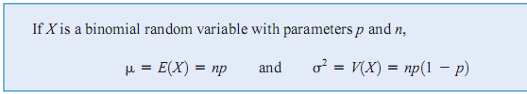
Mean and Variance
Prove it

Slide 12
Ex
Rolls of a four sided die. A bet is placed that a 1 will occur on a single roll of the die.
Thus E={1} →p=1/4
E’={2,3,4}

Slide 13
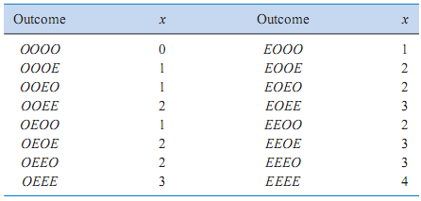
Other example
A bit transmitted through a digital transmission channel is in error is 0.1. Let X=the number of bits in error in the next four bit transmitted
Suppose E: a bit in error

Slide 14
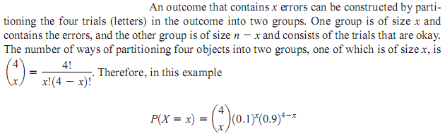
→The event that X=2 consists of the 6 outcome :
{EEOO, EOEO, EOOE, OEEO, OEOE, OOEE}
→Using the assumption that the trials are independent that the probability of the {EEOO} is :

Slide 15
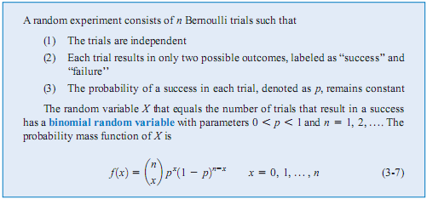

Bernoulli Distr

Slide 16
Example
Each sample of water has a 10% chance of containing a
particular organic pollutant. Assume the samples are independent with regard to the presence of the pollutant.
Find the probability that in the next 18 samples, exactly 2 contain the pollutant.
Let X=the number of samples that contain the pollutant in the next 18 samples analyzed.
Then X is a binomial rV with p=0.1 and n=18
Therefore :

Slide 17
Geometric Distribution
Is a distribution arising from Bernoulli trials is the number of trials to the first occurrence of success
Ex:
The probability that a bit transmitted through a digital transmission channel is received in error is 0.1. Assume the transmissions are independent event and let the rV X denote the number of bits transmitted until the first error

Slide 18
answer
P(X=5) is the probability that the first four bits are transmitted correctly and the fifth bits is in error
Denoted : {OOOOE} where O denotes an okay bit
Because the trial are independent and the probability of a correct transmission is 0.9 then

Slide 19
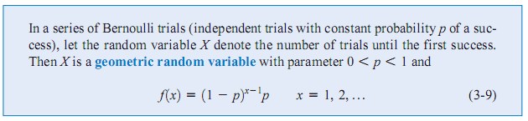
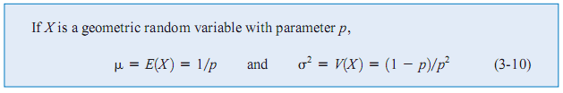
Definition
Prove it (H2)

Slide 20
Negative Binomial distribution
Suppose previously example. Let the RV X denote the number of bits transmitted until the fourth error
Then find P(X=10)

Slide 21
X has a negative binomial distribution with r=4
P(X=10) is the probability that exactly three errors occur in the first nine trials and then trial 10 result in the fourth error
The probability that exactly three errors occur in the first nine trial is determined from the binomial distribution to be
Because the trial are independent, probability that exactly three errors occur in the first 9 trials and trial 10 results in the fourth error is the product of the probabilities of these two events, namely :

Slide 22
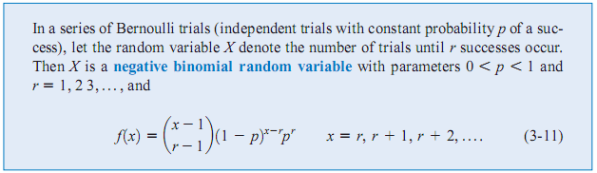
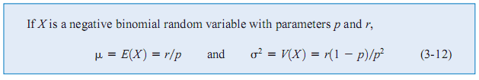
definition
Prove it (H3)

Slide 23
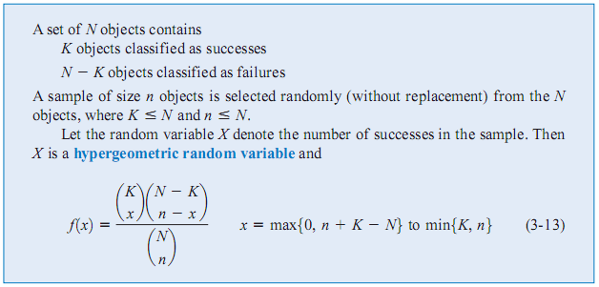
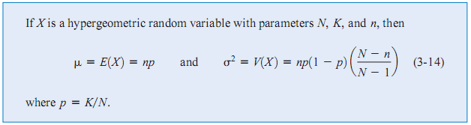
Hypergeometric Distribution
Prove it (H4)

Slide 24
Example
A batch of parts contains 100 parts from a local supplier of tubing and 200 parts from a supplier of tubing in the next state. If four parts are selected randomly and without replacement, what is the probability they are all from the local supplier?

Slide 25
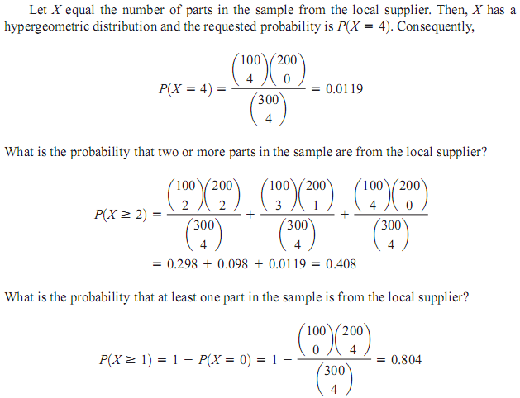

Slide 26
Poisson Distribution
Ex:
→passenger arrivals at an airline terminal
→The distribution of dust particles

Slide 27
Consider the transmission of n bits over a digital communication channel. Let the rV X equal the number of bit error. When the probability that a bit is in error is constant and the transmissions are independent, X has a binomial distribution. Let p denote the probability that a bit is in error. Let
Suppose n increase and p decrease accordingly
such that :

Slide 28
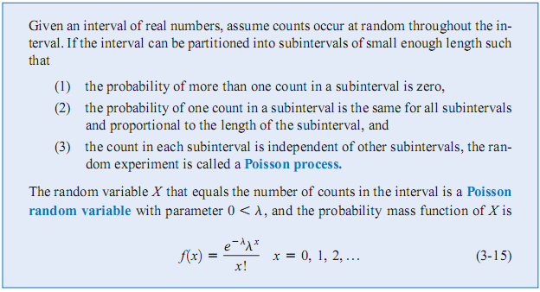
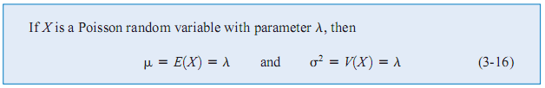
definition

